Slide 1

Big data analytics R - Hadoop
Team – Random R

Slide 2
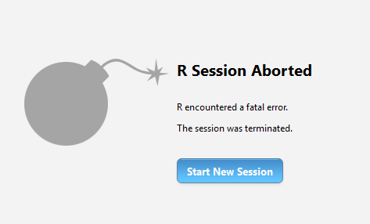
What happens when data gets big?
R loads data into memory
The data may not load in memory
Analyzing data may take long time

Slide 3

Possible Solutions
Sample the data
Use bigger hardware
Split the data and analyze in chunks

Slide 4
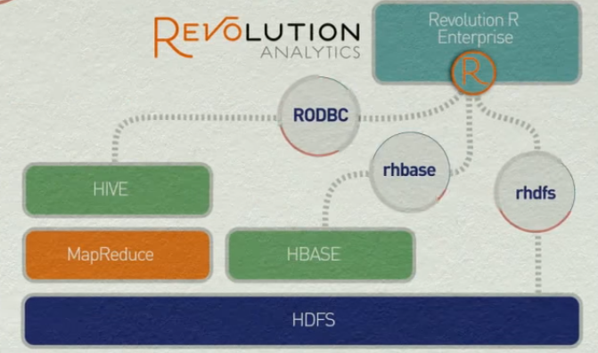
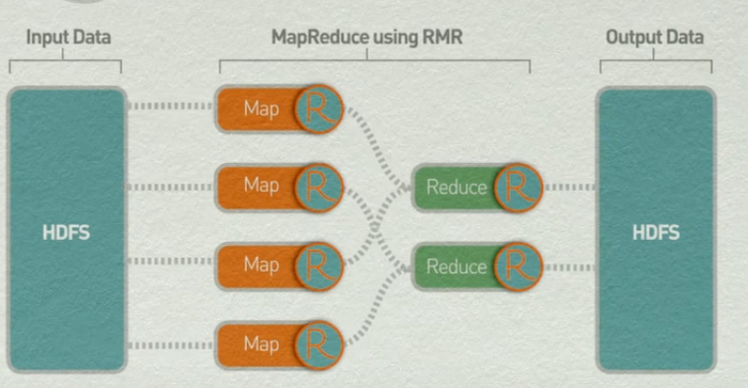
R Hadoop and Packages
RHDFS
RMR2

Slide 5
Setting up the RHadoop Environment
Download Cloudera QuickStart VMware.
Download a VM player (We used VMware Workstation 12).
Install R in the VMware (from the command prompt).
After R is installed, install packages rhdfs, rhbase, plyrmr, rmr2, ravro.
Set up the JAVA_HOME directory path.
Set up the system environment (Hadoop path etc.)

Slide 6
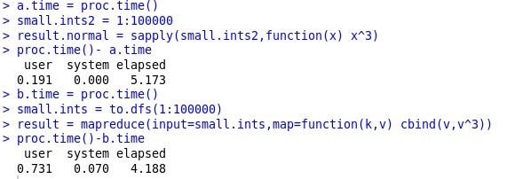
Performance of RHadoop Vs R
Time required to compute using MapReduce is less than R computation time.
For the big data, the computation time is significantly lesser in HDFS using MapReduce.

Slide 7
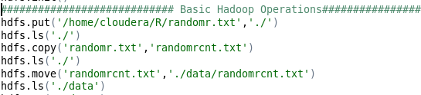
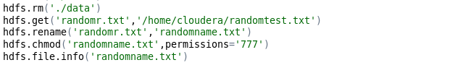
Basic Hadoop Operations
Put: command used to place a file in HDFS from a local system.
Copy: Copies a file in the same directory in HDFS.
Move: Moves a file from one location to other in HDFS.
Delete: Deletes the directory from the HDFS.
Get: Command used to retrieve a file from HDFS to local system.
Rename: Command used to rename a file in HDFS.
Chmod: Command used to change the file permissions in HDFS.

Slide 8
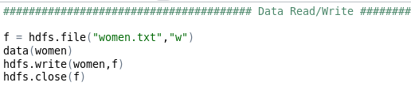
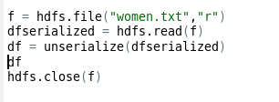
Read and Write Operations
Write:
Open a file in write mode and assign it to an object.
Read the required file and then write the file to the assigned object f and close the object.
Read:
Operation to perform opening and assigning the file to an object in Read mode.
Unserialize function reads an object from connection or a raw vector.

Slide 9
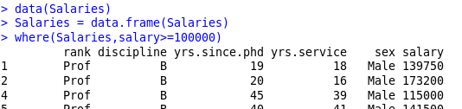
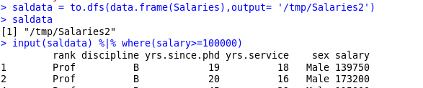
Data Manipulations using PLYRMR
Plyrmr package is analogous to plyr or reshape2 function in R which performs the data manipulation via MapReduce framework.
Filtering the data with salary greater than or equals 100,000 in Salaries dataset.

Slide 10


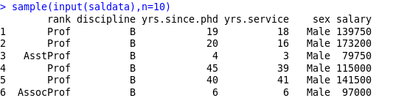
Plyrmr - Manipulations
Compute the mean of salary from the salary data and transmute function is used to restore the results to saldata.
Group the salary by sex
Sampling the 10 records of saldata

Slide 11


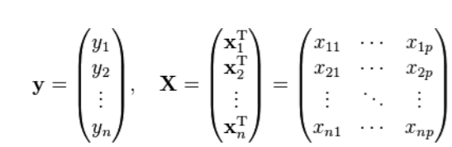


Linear Regression
Solving and is a big data challenge!
20*20
Matrix of the Linear System
20*1
Free Term
Further computations over and . is not a big data challenge
The Call of the function can be classically performed on a single computer

Slide 12
Matrix multiplication and map-reduce
The algorithm for solving the problem of linear regression can be transformed so that it can use the map-reduce programming model which is specific to Hadoop
Matrix multiplication is such a central operation in many numerical algorithms.
One basic matrix multiplication algorithm is “Divide and Conquer”
https://en.wikipedia.org/wiki/Matrix_multiplication_algorithm
One way to implement map-reduce for multiple linear regression is by using the above matrix multiplication algorithm.

Slide 13
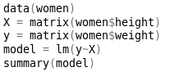
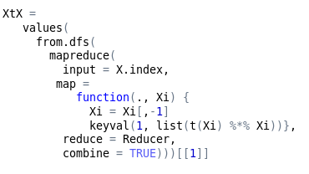
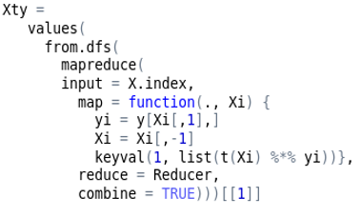

Linear regression – RHadoop vs R

Slide 14
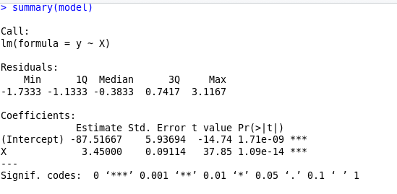

Results comparison
Map Reduce version in R – Hadoop
lm version in R

Slide 15

Notes:
https://www.youtube.com/watch?v=ITdsXmAlQd0&t=9s

Slide 16


Slide 17


